Slide 1
Tax Payers System
By
Brian Nkhata

Slide 2
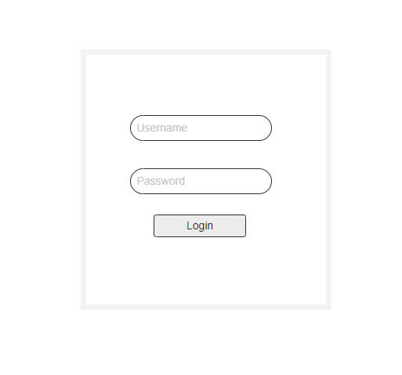
Login Page

Slide 3
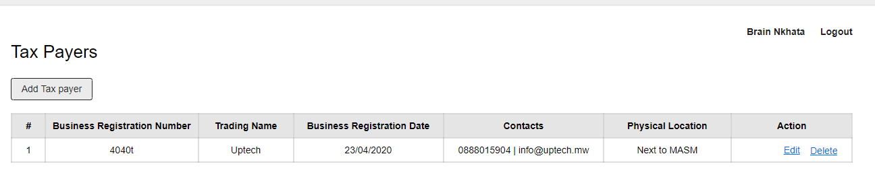
List of tax payers List added by Me

Slide 4
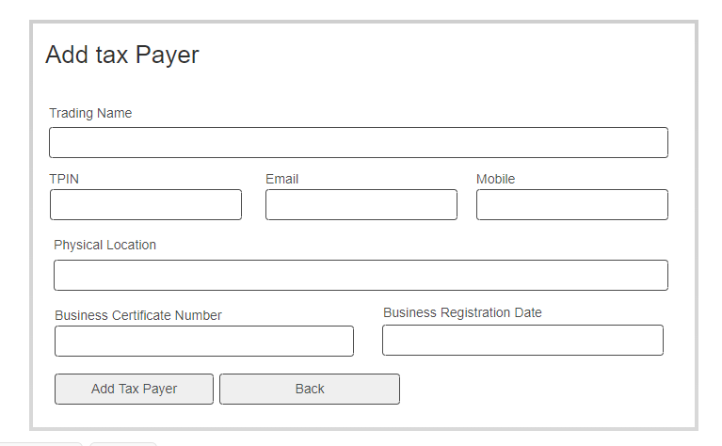
Add tax payer

Slide 5
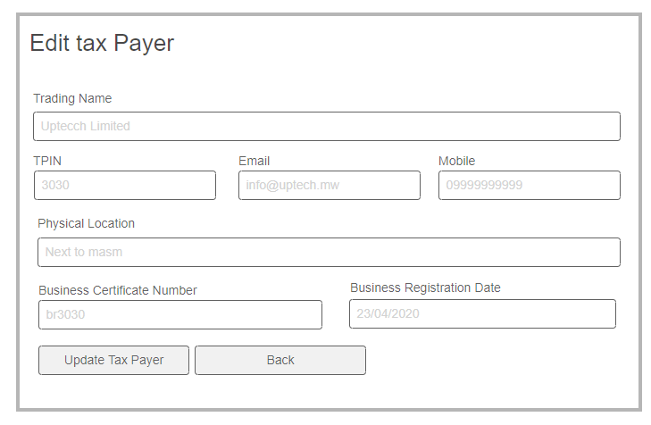
Edit Tax Paper

